Slide 1
PowRL : A Reinforcement Learning Framework for Robust Management of Power Networks

Slide 2
Motivating Example
Figure 1: Reliable operation through bus-splitting: instead of disconnecting the overloaded line, a simpler and
effective solution is to alter the underlying network topology

Slide 3
Grid2Op Environment
Offers flexibility to work with realistic scenarios, execute contingency events.
The challenge scenario consists of industry standard synthetic IEEE-118 network with 36 substations, 59 lines and 22 generators. The remaining part of the IEEE-118 network is represented as an inter-connected load.
Challenge dataset equipped with realistic production and consumption scenarios, as well as adversarial attacks.
Demand-Supply balance should be maintained else episode terminates.

Slide 4
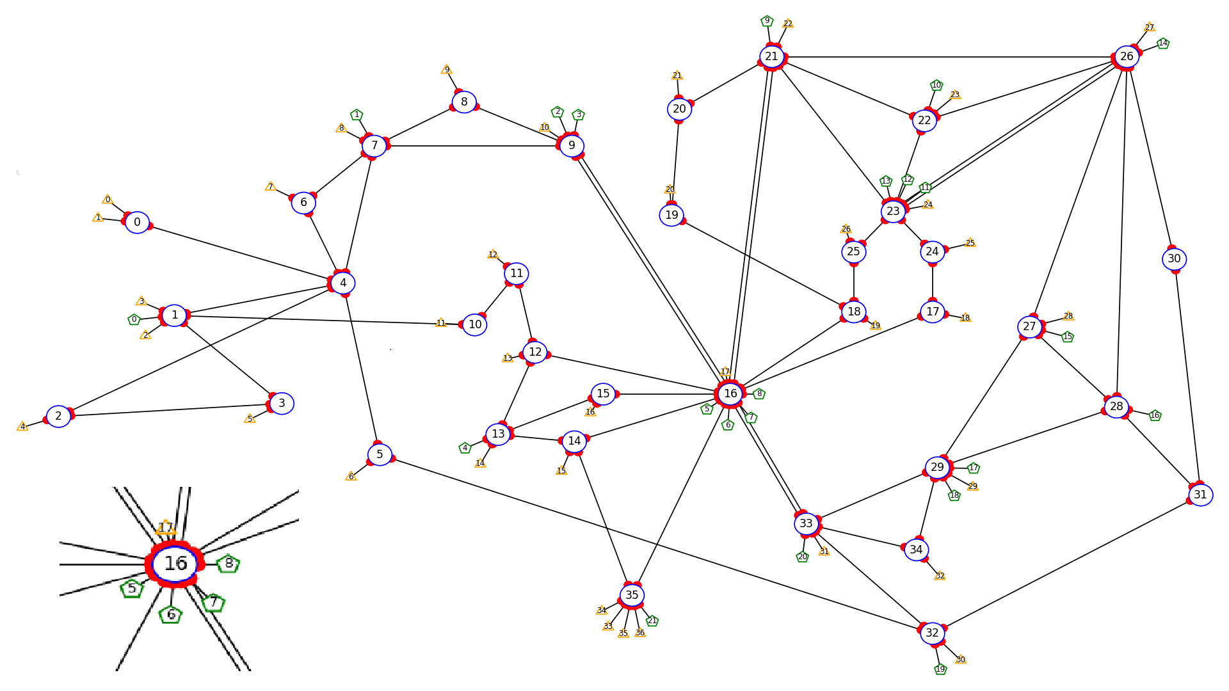
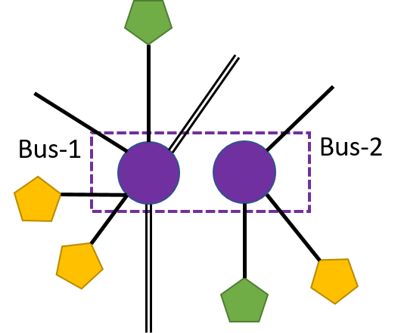
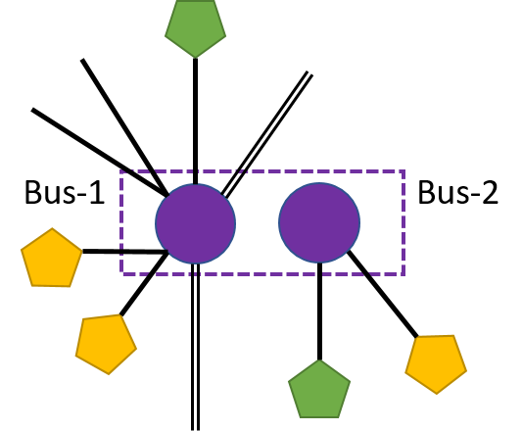
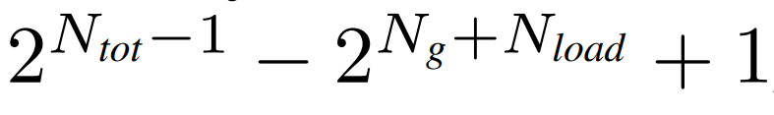
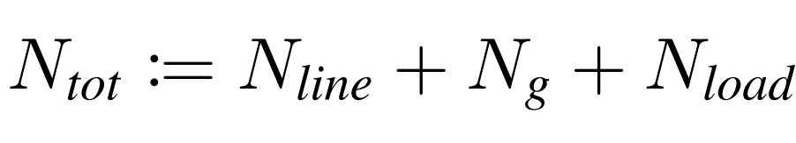
Humongous action space
Figure 3: Examples of Valid (left) and invalid (right) topological configuration at a double busbar substation
The number of valid topological reconfigurations for a double busbar substation comprising of N_{line} lines, N_{g} generators, and N_{load} loads
is
Figure 2: Synthetic IEEE-118 network consisting of 36 substations, 59 lines, 22 generators

Slide 5
Challenges in Controlling Power Network
Combinatorially many actions : The number of actions increases exponentially with the number of elements, and for substation 16 it counts nearly 65k.
Uncertainty with renewables : Weather-related changes that significantly affect power generation may force the operator to take immediate remedial action in order to avoid transmission loss failures or eventual blackouts.
Adversarial attacks : The L2RPN challenge operates with a heuristically designed opponent to mimic the N − 1 security criterion in power networks, it acts in an environment parallel to the RL agent and affects the power grid through forced contingencies.

Slide 6

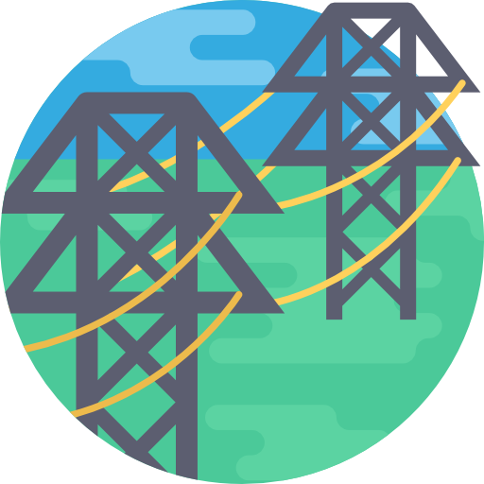

Action
Line action includes the line reconnection/disconnection
Agent can only reconnect lines once the cooldown is over
Do Nothing action
Doesn't change the status of elements and survives nearly 24%
Switching elements bus at the substation.
Flexibility offered is un-explored due very large action space
Generator redispatch actions modify production to operate power network
Results in high operating cost

Slide 7
Rules and Evaluation
Constraints:
Demand-Supply balance should be maintained at any time without load shedding
Electrical islands are not allowed
Tripping of power plant not allowed
Action on an element has certain cooldown to avoid degradation cost
Evaluation:
In NeurIPS challenge data, agent is evaluated over 24 episodic weekly scenarios
In WCCI challenge dataset, agent is evaluated over 10 different 3-day long scenarios
Score is calculated based on operating cost and losses due to blackout
Agent with less operating cost and less blackout will get higher score

Slide 8
PPO
PPO trains a stochastic policy in an on-policy way.
PPO can be used for environments with either discrete or continuous action spaces.
There are two primary variants of PPO: PPO-Penalty and PPO-Clip.
PPO-Penalty approximately solves a KL-constrained update like TRPO, but penalizes the KL-divergence in the objective function instead of making it a hard constraint, and automatically adjusts the penalty coefficient over the course of training so that it’s scaled appropriately.
PPO-Clip doesn’t have a KL-divergence term in the objective and doesn’t have a constraint at all. Instead relies on specialized clipping in the objective function to remove incentives for the new policy to get far from the old policy.
Ref : https://spinningup.openai.com/en/latest/algorithms/ppo.html?highlight=PPO#documentation-pytorch-version

Slide 9
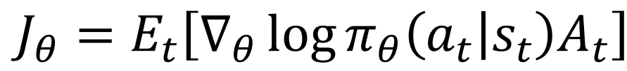
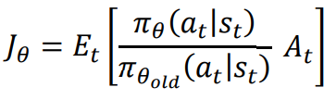
PPO
A2C objective could be written as,
The new objective proposed by PPO is,
However, if we just start to blindly maximize this value, it may lead to a very large update to the policy weights. To limit the update, the clipped objective is used.

Slide 10
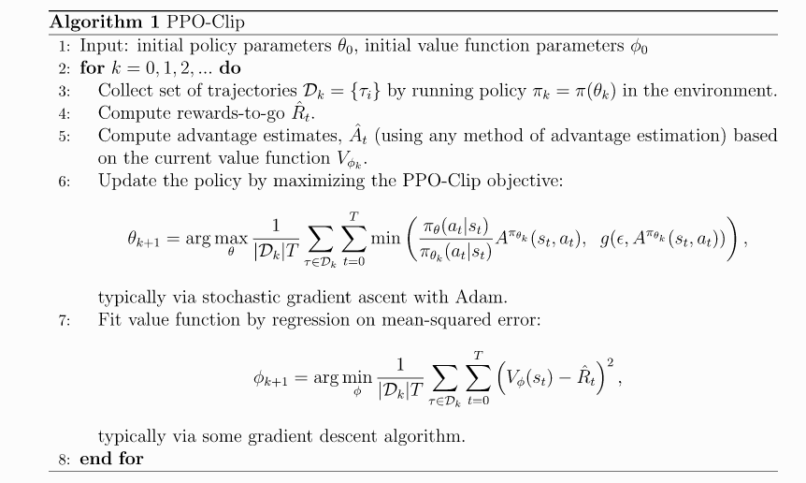
PPO Algorithm
Ref : https://spinningup.openai.com/en/latest/algorithms/ppo.html?highlight=PPO#documentation-pytorch-version

Slide 11
State
Time-step information (t) : month, date, hour, minute and day of week
Generator features (F_{gen}) : P_{gen} , Q_{gen} , V_{gen}
Load features (F_{load}) : P_{load} , Q_{load} , V_{load}
Line features (F_{line}) : P_{or} , Q_{or} , V_{or} , a_{or} , P_{ex} , Q_{ex} , V_{ex} , a_{ex}
Other features are line status (I₁), line rho value (ρ), topology vector of the power grid (I_{topo_vect}), timestep overflow (t_{of}), cooldown period of line (t_{l}) and substations (t_{s}) and the time of next planned maintenance t_{nm} and its duration t_{d.}
St := [t , F_{gen} , F_{load} , F_{line} , I₁ , ρ , I_{topo_vect} , t_{of} , t_{l} , t_{s} , t_{nm} , t_{d}]

Slide 12
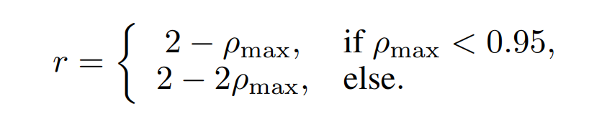
Actions and Reward
Action
The action space is a set of 240 topological actions.
These action are picked based on their impact on network control through extensive simulation.
Reward
The step reward is designed to incur additional penalty when the maximum line rho ρ_{max} exceeds the ρ_{safety threshold} of 0.95,

Slide 13
Heuristic-guided topological actions
Disengage RL agent during ‘acceptable’ grid operation
Manually disconnect a line during sustained periods of overflow in order to avoid permanent damage, as well as allowing PowRL to reconnect the line back soon after the cooldown period ends.
Any network reconfigurations are restored to original state as soon as the contingency ends
Reconnect the line back soon the scheduled maintenance period is over
Do not disconnect lines that result in network bifurcation

Slide 14
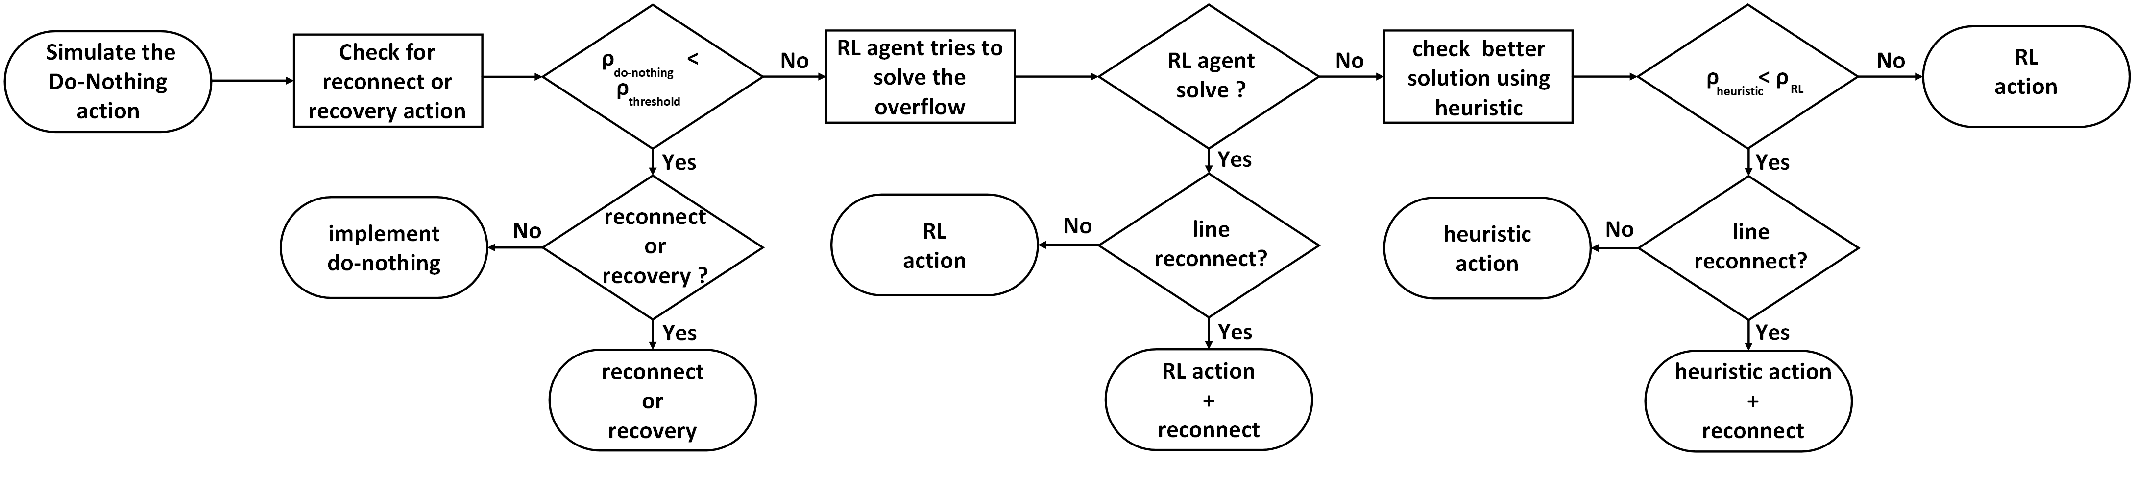
Optimal Action Selection
Figure 4: Schematic of PowRL: PowRL combines RL-agent with a threshold based heuristic scheme

Slide 15
Experiments
PowRL runs on Grid2Op, which emulates the sequential decision-making in the power system, where each episode is divided into a list of states each corresponding to a time step of 5 minutes.
Lightsim2grid backend to the Grid2Op platform in order to accelerate the computation.
Agent is evaluated over three different datasets;
NeurIPS 2020 L2RPN Online data
NeurIPS 2020 L2RPN Offline data
WCCI 2020 L2RPN offline data

Slide 16
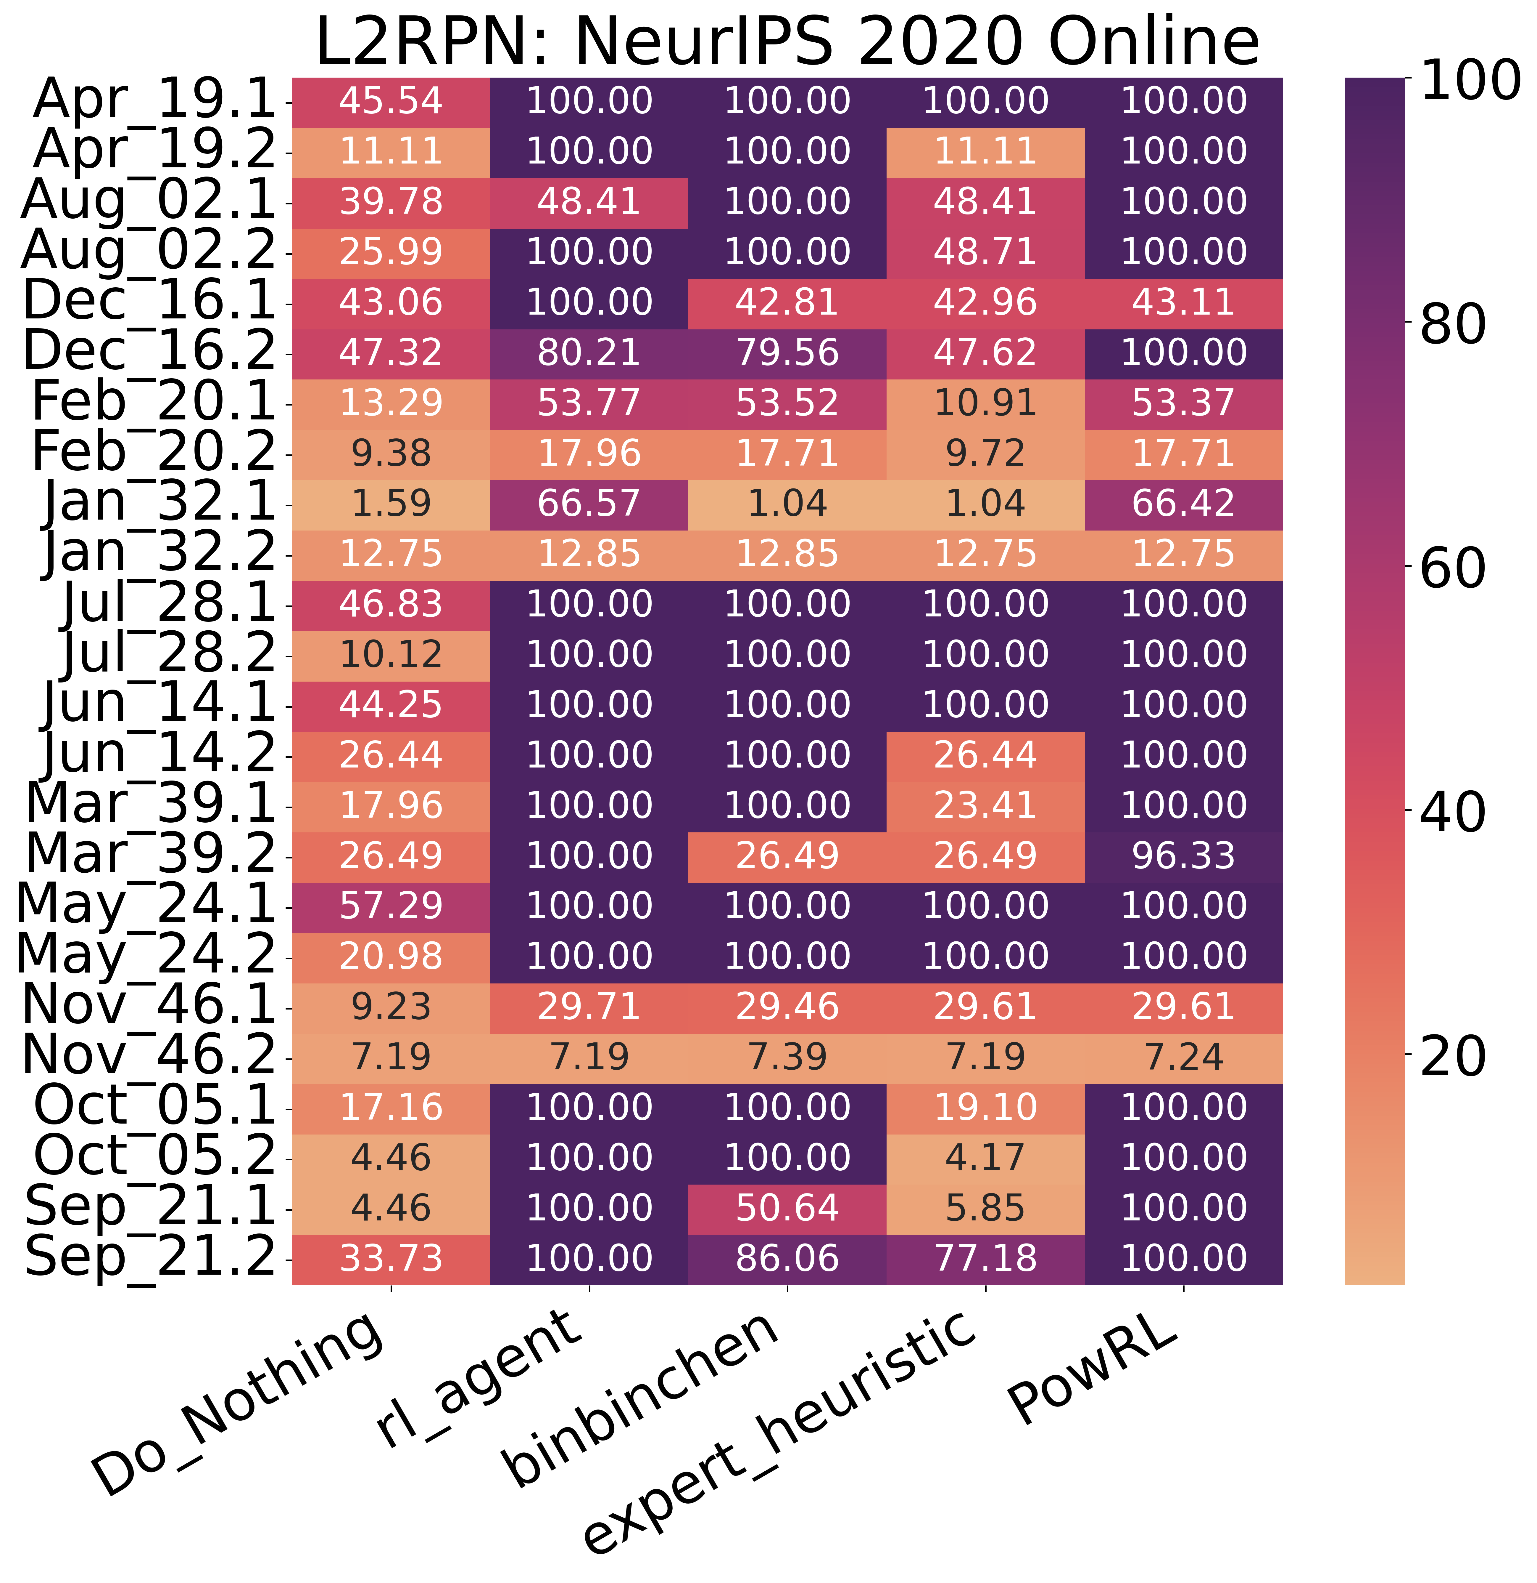
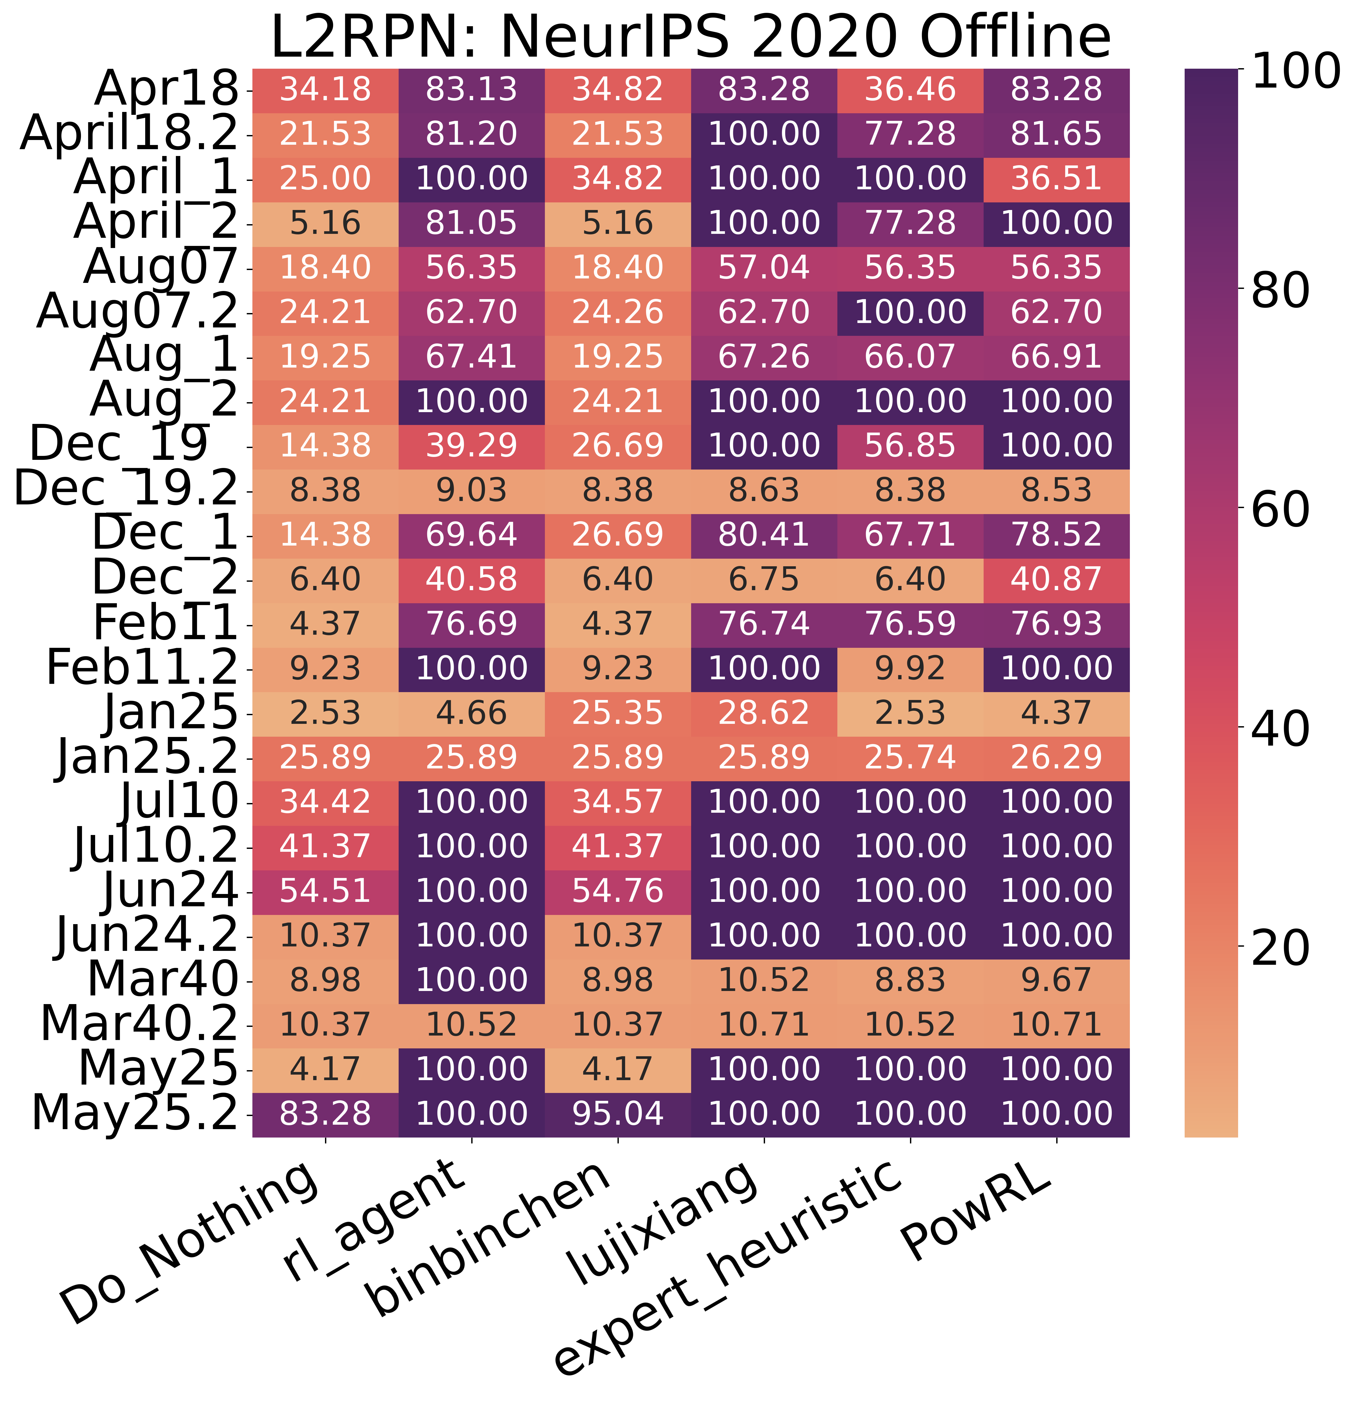
Results
Figure 5: Survival percentages of various agents on the L2RPN NeurIPS 2020 challenge Online dataset
Figure 6: Survival percentages of various agents on the L2RPN NeurIPS 2020 challenge Offline dataset

Slide 17
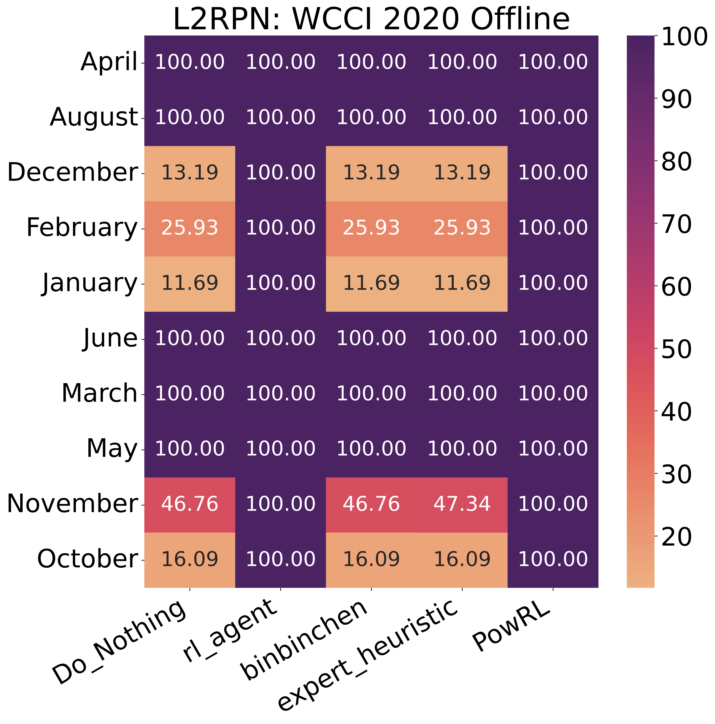
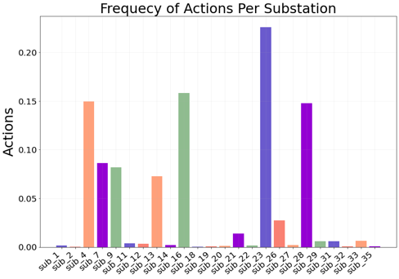
Results
Figure 7: Survival percentages of various agents on the L2RPN WCCI 2020 challenge (Offline)
Figure 8: Diversity of remedial actions distributed across multiple substations.

Slide 18
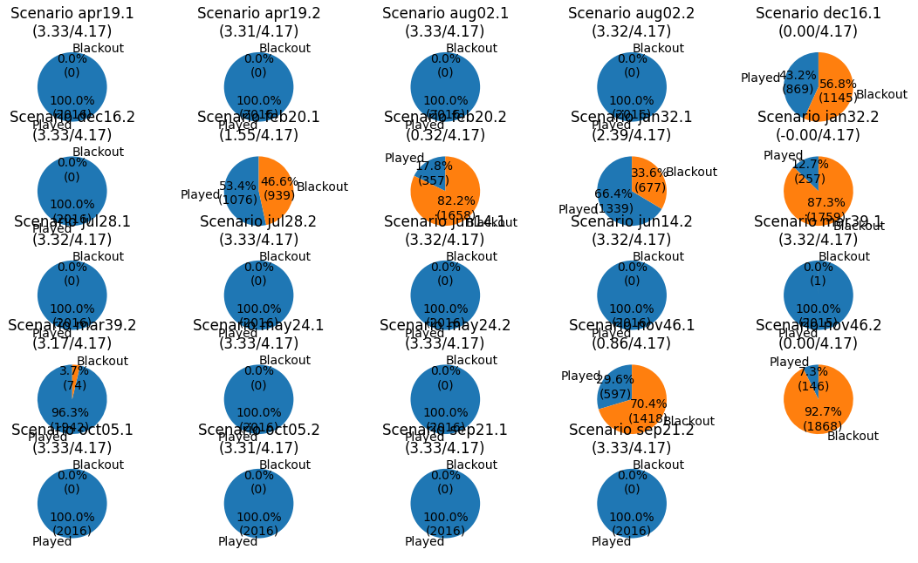
Results
Figure 9: Scenario-wise survival percentage and scores on the L2RPN NeurIPS 2020 challenge data (Online)

Slide 19
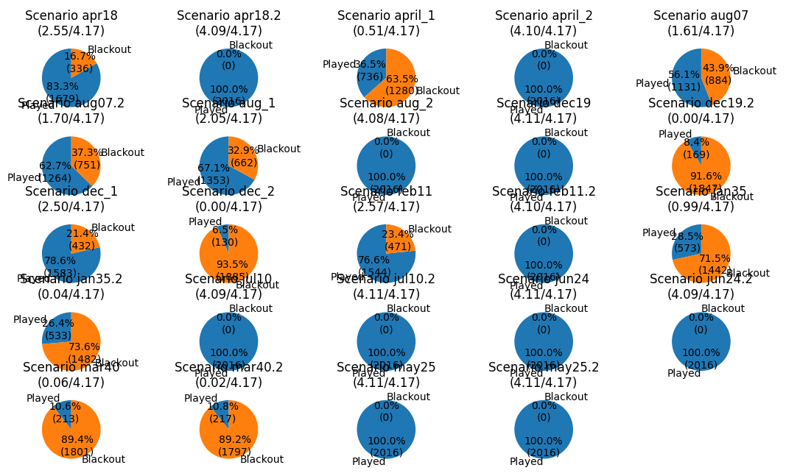
Results
Figure 10: Scenario-wise survival percentage and scores on the L2RPN NeurIPS 2020 challenge data (Offline)

Slide 20
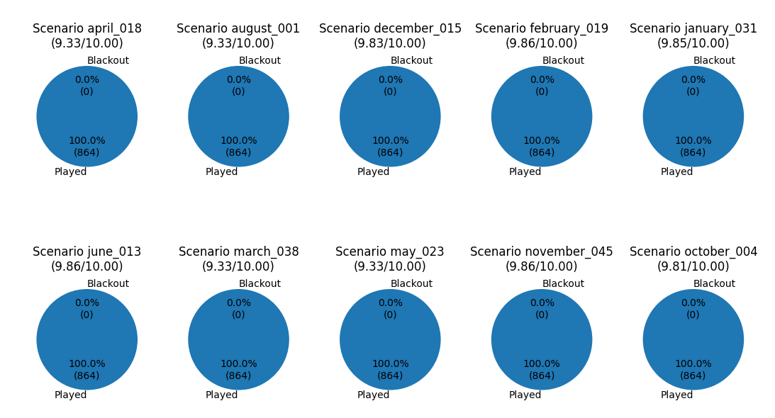
Results
Figure 11: Scenario-wise survival percentage and scores on the L2RPN WCCI 2020 challenge data (Offline)

Slide 21
Summary
Method | NeurIPS (Online) | NeurIPS (Offline) | WCCI | # actions | Run-time (s)
Do_Nothing | 0 | 0.34 | 50.09 | NA | 0.54
expert_heuristic | 22.53 | 51.44 | 50.1 | NA | 9.76
lujixiang | 45 | 53.96 | NA | 885 | 824.58
binbinchen | 52.42 | 3.96 | 51.1 | 208 + 1255 | 503.88
rl_agent | 61.05 | 61.06 | 96.4 | 232 + 500 + redispatch | 358.82
PowRL (Ours) | 61.48 | 59.69 | 96.4 | 206 + 34 | 353.36
Table 1: Performance on L2RPN Challenge Datasets

